Slide 1
COMPUTER VISION

Slide 2
What is Computer Vision?
We are currently living in an age of AI revolution, marked by impressive advancements in the field of deep learning.
In just the past few months, we’ve witnessed applications of artificial intelligence that stunned the world by generating realistic pieces of artwork, passing the bar exam, and writing Python code to create websites.
Computer vision is a deep learning application that lies at the heart of this revolution.
It allows computers to derive insight from visual input such as images and video files.
Examples of computer vision include face detection, facial recognition, human pose estimation, and obstacle detection.In this tutorial, we will explore how to perform face detection with OpenCV, looking at both still and real-time images

Slide 3
Applications of Computer Vision:
Why do we need computer vision when human vision is a relatively trivial task for most humans to accomplish?
While it is true that humans can perform visual tasks with ease and require only a few data samples, AI is highly scalable. Computer vision models can process millions of data points when deployed in surveillance and autonomous vehicles.
This is a scale that simply cannot be achieved by human vision.
Furthermore, computer vision applications can be integrated into sensors, cameras, and intelligent devices for real-time image processing that involves 24/7 operation. Again, this is an incredibly challenging feat for humans to achieve.
Finally, AI is not susceptible to biases, fatigue, and inattention.
While humans may get tired and overlook a security breach, a computer vision application will never falter, thereby reducing the risk of missed incidents.

Slide 4
Let’s look at some real-world applications of computer vision in our daily lives:
Surveillance:
Computer vision applications such as object recognition and pose estimation are often deployed in security devices to automate human surveillance.
A pose estimation model, for instance, can track a person’s body language to gauge if they are inciting violence, experiencing a medical emergency, or are about to steal something.
These systems can then trigger a notification that alerts the relevant authorities for assistance, decreasing response times and improving public safety.

Slide 5
Retail:
Computer vision models can be deployed in retail outlets to track customers’ eye position, body language, and movement around the store.
These algorithms can provide retailers with the following insight into user behavior:
Are there any specific promotions or products that capture people’s attention and draw them into the store?
What path do customers typically take when in the store?
What type of product placement sparks the most attention?
How often do customers engage with promotional materials such as banners and signage?
Retailers can then use these insights to improve the store’s marketing strategy and customize product placement to drive sales.

Slide 6
Autonomous Vehicles:
The field of autonomous driving has benefited tremendously from computer vision technologies.
Object detection models are deployed in vehicles to identify pedestrians, other vehicles, and animals on the road.
Computer vision applications can interpret stop signs and traffic lights, accurately estimate the distance between the vehicle and other objects, and avoid obstacles like potholes to ensure a safe driving experience.

Slide 7
Introduction to OpenCV:
Now that we understand just how useful computer vision applications are, let’s examine a popular tool used to implement them. OpenCV is a computer vision library that supports programming languages like Python, C++, and Java.
The package was initially created by Intel in 1999 and was later made open-source and released to the public.
OpenCV allows developers and non-mathematicians to build computer vision applications easily without having to code them from scratch. The library has over 2,500 algorithms that allow users to perform tasks like face recognition and object detection.
Developers and data practitioners at well-established organizations like Google, Microsoft, IBM, and Intel make extensive use of the OpenCV library, which is currently free for commercial use.
In this slides, we will use OpenCV to perform face detection in Python.
By the end of this Slide, you will know how to:
Detect human faces in images with OpenCV in Python
Perform real-time face detection in a live stream from a webcam
Recognize and label celebrity faces in images

Slide 8
What is Face Detection?
Face detection involves identifying a person’s face in an image or video. This is done by analyzing the visual input to determine whether a person’s facial features are present.
Since human faces are so diverse, face detection models typically need to be trained on large amounts of input data for them to be accurate. The training dataset must contain a sufficient representation of people who come from different backgrounds, genders, and cultures.
These algorithms also need to be fed many training samples comprising different lighting, angles, and orientations to make correct predictions in real-world scenarios.
These nuances make face detection a non-trivial, time-consuming task that requires hours of model training and millions of data samples.
Thankfully, the OpenCV package comes with pre-trained models for face detection, which means that we don’t have to train an algorithm from scratch. More specifically, the library employs a machine learning approach called Haar cascade to identify objects in visual data.

Slide 9
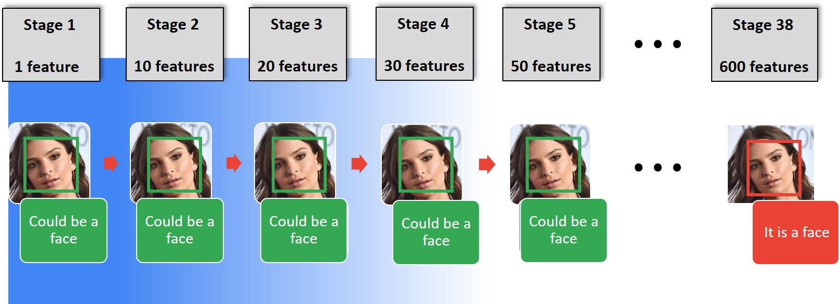

Slide 10
Intro to Haar Cascade Classifiers:
Haar cascade is an algorithm that can detect objects in images, irrespective of their scale in image and location.
This algorithm is not so complex and can run in real-time. We can train a haar-cascade detector to detect various objects like cars, bikes, buildings, fruits, etc.
Haar cascade uses the cascading window, and it tries to compute features in every window and classify whether it could be an object.
Haar cascade works as a classifier. It classifies positive data points → that are part of our detected object and negative data points → that don’t contain our object.
Haar cascades are fast and can work well in real-time.
Haar cascade is not as accurate as modern object detection techniques are.
Haar cascade has a downside. It predicts many false positives.
Simple to implement, less computing power required.

Slide 11
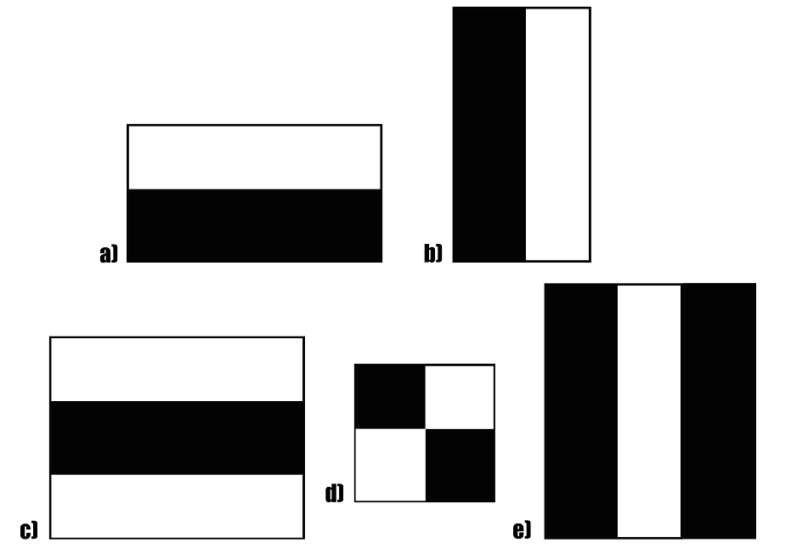

Slide 12
Implementing Haar-cascades in OpenCV;
If you find your target object haar-cascade available in the pre-trained repository provided by OpenCV, you need to download the pre-trained XML file.
Installing OpenCV in Python
!pip install opencv-python
#---OR ---
!pip install opencv-contrib-python
Loading Haar Cascade in OpenCV
We can load any haar-cascade XML file using cv2.CascadeClassifier function.
face_detector=cv2.CascadeClassifier(‘haarcascade_frontalface_default.xml’)
eye_dectector = cv2.CascadeClassifier(‘haarcascade_eye.xml’)
Once cascade is loaded in OpenCV, we can call the detector function.
results = face_detector.detectMultiScale(gray_img, scaleFactor=1.05,minNeighbors=5,minSize=(30, 30), flags=cv2.CASCADE_SCALE_IMAGE)

Slide 13
Parameters in detectMultiScale:
scaleFactor – This tells how much the object’s size is reduced in each image.
minNeighbors – This parameter tells how many neighbours each rectangle candidate should consider.
minSize — This signifies the minimum possible size of an object to be detected. An object smaller than minSize would be ignored.
Note : For detection, we must pass a gray_image , scaleFactor, and minNeighbors. Other parameters are optional.
Simple Detection of the Human Face
This is the first example of object detection using a haar cascade, where we will detect human faces from a picture using a pre-trained haar cascade

Slide 14
import numpy as np
import cv2
#---loading haarcascade detector---face_detector=cv2.CascadeClassifier('haarcascade_frontalface_default.xml')
#---Loading the image-----
img = cv2.imread('team_india.jpg')
gray = cv2.cvtColor(img, cv2.COLOR_BGR2GRAY)
faces = face_detector.detectMultiScale(gray, 1.3, 5)
for (x,y,w,h) in faces:
cv2.rectangle(img,(x,y),(x+w,y+h),(0,255,0),2)
cv2.imshow('img',img)
cv2.waitKey(0)
cv2.destroyAllWindows()

Slide 15
faces It contains the coordinates of bounding boxes around detected faces.
detectMultiScale This method only accepts grayscale pictures.
cv2.rectangle This method draws rectangles (bounding boxes around the detected face).
scaleFactor = 1.3 We can try a number between 1 and 2 and later fine-tune it.
Hierarchical Detection:
Haar cascade can detect multiple objects within a single frame in a hierarchical manner.
Imagine we have to detect the faces and eyes of humans. To proceed with this problem, we need to follow the steps:
Detect Human faces
For every face, crop faces and pass it for eye detection
after getting the coordinates of the eyes (ex,ey,ew,eh) draw bounding boxes for the eyes on the original picture
draw bounding box for faces using coordinates(x,y,w,h) on the original picture.

Slide 16
import numpy as np
import cv2
face_detector=cv2.CascadeClassifier('haarcascade_frontalface_default.xml')
eye_detector = cv2.CascadeClassifier('haarcascade_eye.xml')
img = cv2.imread('.jpg')
gray = cv2.cvtColor(img, cv2.COLOR_BGR2GRAY)
faces = face_detector.detectMultiScale(gray, 1.3, 5)
for (x,y,w,h) in faces:
img = cv2.rectangle(img,(x,y),(x+w,y+h),(255,0,0),2)
roi_gray = gray[y:y+h, x:x+w]
roi_color = img[y:y+h, x:x+w]
#-----roi_gray is the cropped detected face in grayscale
# --- roi_color is the cropped detected face in color
eyes = eye_detector.detectMultiScale(roi_gray)
for (ex,ey,ew,eh) in eyes:
cv2.rectangle(roi_color,(ex,ey),(ex+ew,ey+eh),(0,255,0),2)
cv2.imshow('img',img)
cv2.waitKey(0)
cv2.destroyAllWindows()

Slide 17
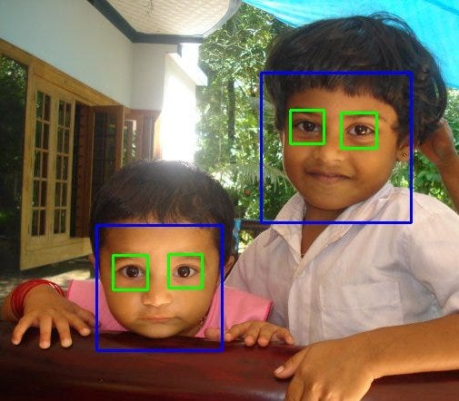
roi_gray : region of interest(cropped face) in grayscale
roi_color : region of interest(cut face) in colour

Slide 18
Object Detection in Real-time:
So far, we have worked on a single image.
The haar-cascade algorithm is light and works in real-time with a perfect frame per second.
We will be using OpenCV video cam feed input to take images in real-time (video).

Slide 19
import cv2
face_detector = cv2.CascadeClassifier('haarcascade_frontalface_default.xml')
eye_dectector = cv2.CascadeClassifier('haarcascade_eye.xml’)
# reading the input image now
cap = cv2.VideoCapture(0)
while cap.isOpened():
_, frame = cap.read()
gray = cv2.cvtColor(frame, cv2.COLOR_BGR2GRAY)
faces = face_detector.detectMultiScale(gray,1.1, 4 )
for (x,y, w, h) in faces:
cv2.rectangle(frame, pt1 = (x,y),pt2 = (x+w, y+h), color = (255,0,0),thickness = 3)
roi_gray = gray[y:y+h,x:x+w]
roi_color = frame[y:y+h, x:x+w]
eyes = eye_dectector.detectMultiScale(roi_gray)
for (ex,ey, ew, eh) in eyes:
cv2.rectangle(roi_color, (ex,ey), (ex+ew, ey+eh), (0,255,0), 5)
cv2.imshow("window", frame)
if cv2.waitKey(1) & 0xFF == ord('q'):
break
frame.release()
This output the face and eyes detection in real-time.

Slide 20
Limitation of Haar Cascade:
We have seen haar cascade performing very well, but there are several limitations of haar cascade.
High false-positive detection
Less accurate than deep learning-based techniques
Manual tuning of parameters.
Training haar cascade on a custom object is not easy.

Slide 21
CASE STUDY:
Installing OpenCV for Python
To install the OpenCV library, simply open your command prompt or terminal window and run the following command:
pip install opencv-python
PROBLEM STATEMENT :
FACE DETECTION BY OPENCV

Slide 22
OpenCV for Face Detection in Images:
We will build a detector to identify the human face in a photo from Unsplash.
Make sure to save the picture to your working directory and rename it to input_image before coding along.
Step 1: Import the OpenCV Package
Now, let’s import OpenCV and enter the input image path with the following lines of code:
import cv2
imagePath = 'input_image.jpg’
Step 2: Read the Image
Then, we need to read the image with OpenCV’s imread() function:
img = cv2.imread(imagePath)
This will load the image from the specified file path and return it in the form of a Numpy array.

Slide 23
Let’s print the dimensions of this array:
img.shape
(4000, 2667, 3)
Notice that this is a 3-dimensional array. The array’s values represent the picture’s height, width, and channels respectively. Since this is a color image, there are three channels used to depict it - blue, green, and red (BGR).
Note that while the conventional sequence used to represent images is RGB (Red, Blue, Green), the OpenCV library uses the opposite layout (Blue, Green, Red).
Step 3: Convert the Image to Grayscale
To improve computational efficiency, we first need to convert this image to grayscale before performing face detection on it:
gray_image = cv2.cvtColor(img, cv2.COLOR_BGR2GRAY)
Let’s now examine the dimensions of this grayscale image:
gray_image.shape
(4000, 2667)
Notice that this array only has two values since the image is grayscale and no longer has the third color channel.

Slide 24
Step 4: Load the Classifier
Let’s load the pre-trained Haar Cascade classifier that is built into OpenCV:
face_classifier = cv2.CascadeClassifier(
cv2.data.haarcascades + "haarcascade_frontalface_default.xml"
)
Notice that we are using a file called haarcascade_frontalface_default.xml.
This classifier is designed specifically for detecting frontal faces in visual input.
OpenCV also provides other pre-trained models to detect different objects within an image - such as a person’s eyes, smile, upper body, and even a vehicle’s license plate.

Slide 25
Step 5: Perform the Face Detection:
We can now perform face detection on the grayscale image using the classifier we just loaded:
face = face_classifier.detectMultiScale(
gray_image, scaleFactor=1.1, minNeighbors=5, minSize=(40, 40)
)
Let’s break down the methods and parameters specified in the above code:
detectMultiScale():The detectMultiScale() method is used to identify faces of different sizes in the input image.
grey_image:The first parameter in this method is called grey_image, which is the grayscale image we created previously.
scaleFactor:This parameter is used to scale down the size of the input image to make it easier for the algorithm to detect larger faces. In this case, we have specified a scale factor of 1.1, indicating that we want to reduce the image size by 10%.

Slide 26
minNeighbors: The cascade classifier applies a sliding window through the image to detect faces in it. You can think of these windows as rectangles.
Initially, the classifier will capture a large number of false positives. These are eliminated using the minNeighbors parameter, which specifies the number of neighboring rectangles that need to be identified for an object to be considered a valid detection.
To summarize, passing a small value like 0 or 1 to this parameter would result in a high number of false positives, whereas a large number could lead to losing out on many true positives.
The trick here is to find a tradeoff that allows us to eliminate false positives while also accurately identifying true positives.
minSize: Finally, the minSize parameter sets the minimum size of the object to be detected. The model will ignore faces that are smaller than the minimum size specified

Slide 27
Step 6: Drawing a Bounding Box
Now that the model has detected the faces within the image, let’s run the following lines of code to create a bounding box around these faces:
for (x, y, w, h) in face:
cv2.rectangle(img, (x, y), (x + w, y + h), (0, 255, 0), 4)
The face variable is an array with four values: the x and y axis in which the faces were detected, and their width and height.
The above code iterates over the identified faces and creates a bounding box that spans across these measurements.
The parameter 0,255,0 represents the color of the bounding box, which is green, and 4 indicates its thickness.

Slide 28
Step 7: Displaying the Image:
To display the image with the detected faces, we first need to convert the image from the BGR format to RGB:
img_rgb = cv2.cvtColor(img, cv2.COLOR_BGR2RGB)
Now, let’s use the Matplotlib library to display the image:
import matplotlib.pyplot as plt
plt.figure(figsize=(20,10))
plt.imshow(img_rgb)
plt.axis('off')

Slide 29
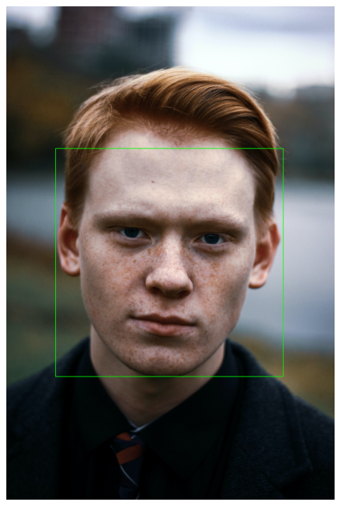
The above code should generate the following output:
Great!
The model has successfully detected the human face in this image and created a bounding box around it.

Slide 30
THE END

